Slide 1
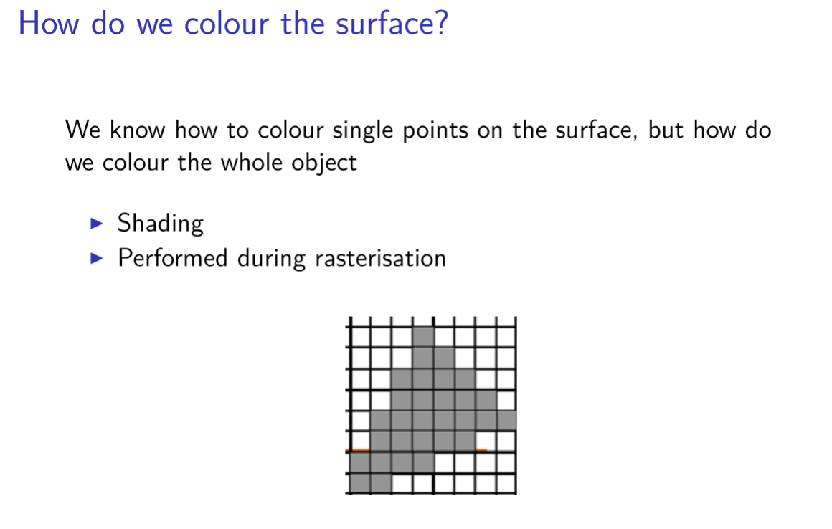
Shading Model

Slide 2
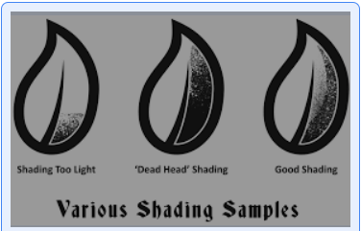
Shading Model

Slide 3
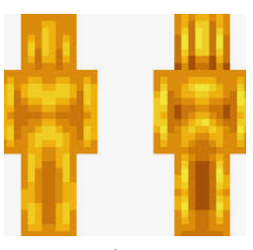
Shading Model

Slide 4
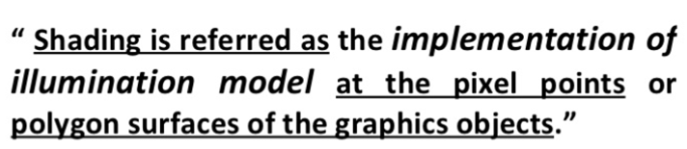
Shading Model

Slide 5
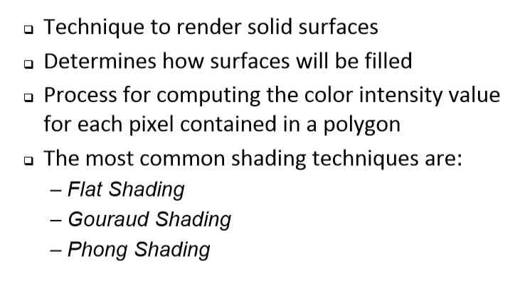
Shading Model

Slide 6
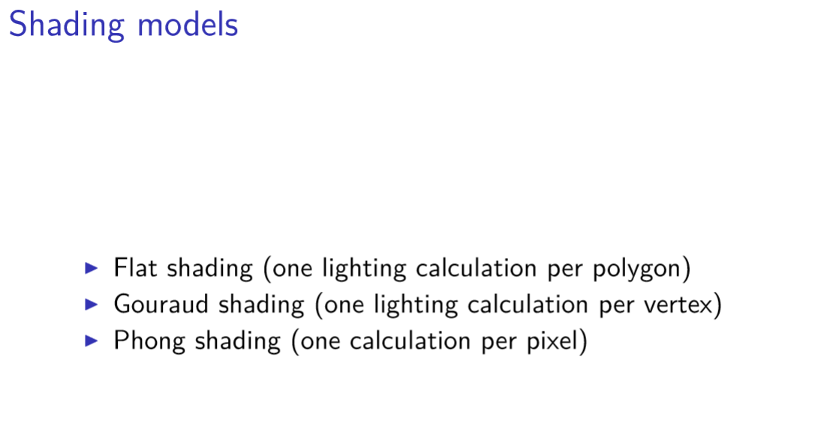
Shading Model

Slide 7
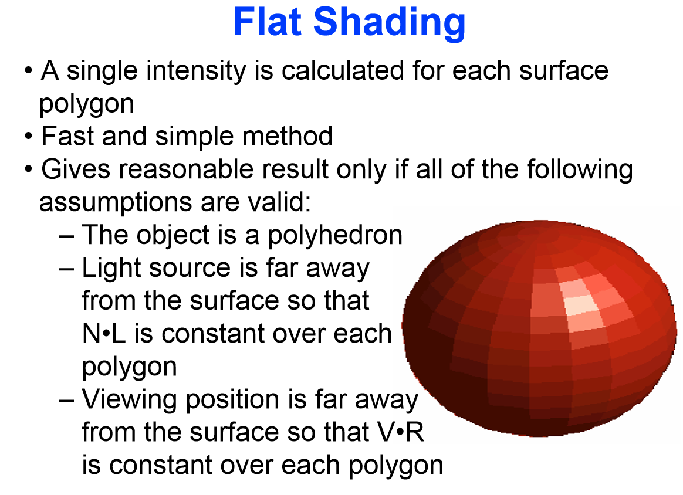

Slide 8
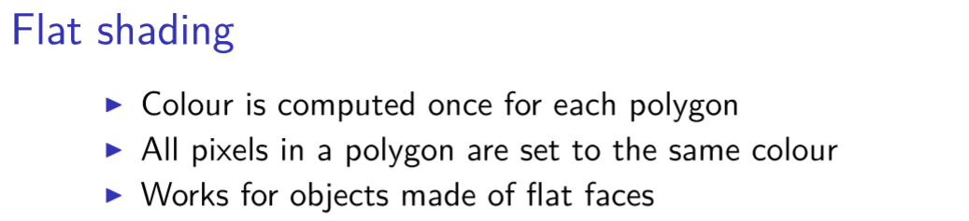
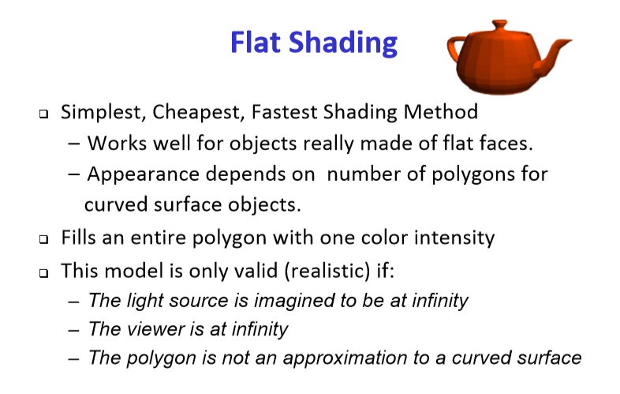

Slide 9
Flat Shading/Constant Intensity Shading
This is the most simple and very fast method to specify color for an object.
Flat shading of a polygon assumes that each polygon is strictly planar and all the points
on the polygon have exactly the same kind of lighting treatment.
This shading technique thus displays all the points in a polygon with a single color.
It defines a single color for a face implementation of it may vary but the main idea is
that we use only one surface normal per polygon.
Disadvantages: Discontinuity of colors can be observed in different faces of the polygon.
Advantages:Fast - one shading value computation per polygon .

Slide 10
Gouraud Shading
This was invented as an improvement to allow for more smooth tansitions of the
Color on round objects.
It is the form of interpolation shading.
Intensity levels are calculated at each vertex and interpolated across the surface.
This intensity interpolation scheme renders the polygon surface by linerally
interpolating intensity values across the surface. Intensity values for each polygon are
matched with the values of adjacent polygons along the common edges.
Thus it eliminates the intensity discontinuities that occurs in flat shading.
This technique uses the concept of intensity interpolation, hence it is also known
as intensity interpolation or color interpolation shading.

Slide 11
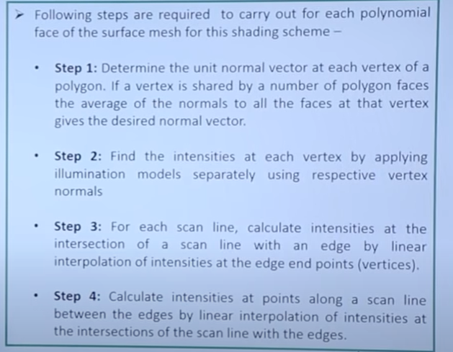
Steps for Gouraud Shading Algorithms

Slide 12
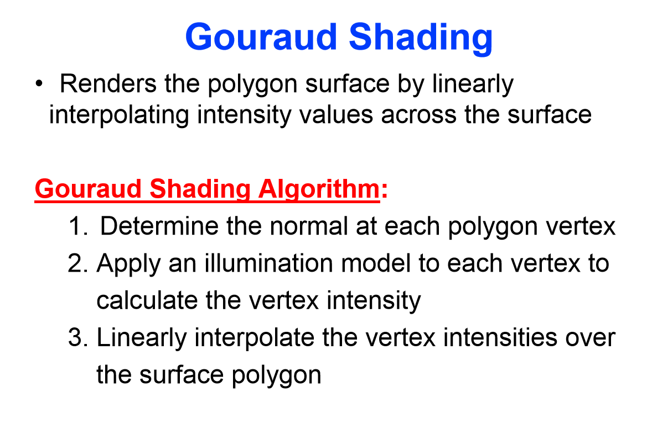

Slide 13
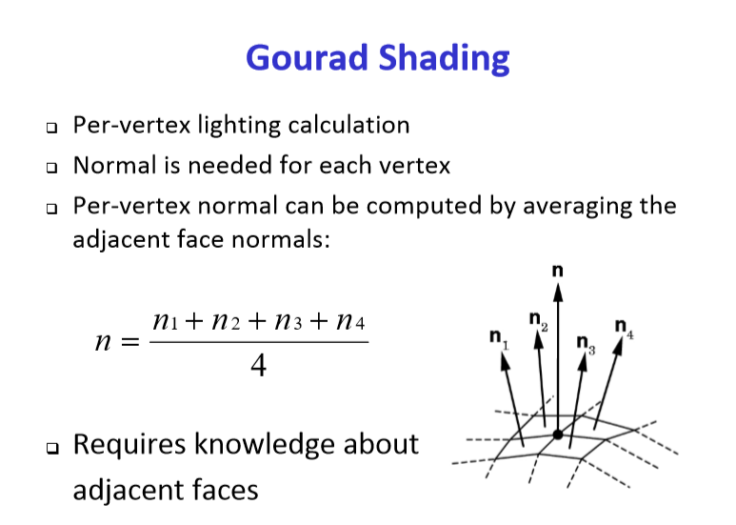

Slide 14
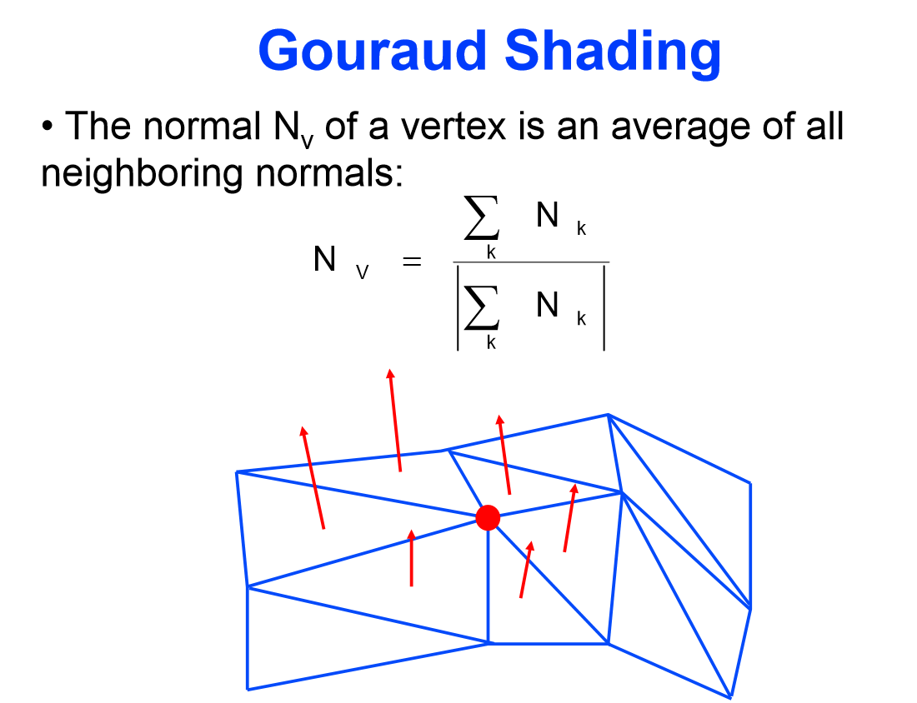

Slide 15
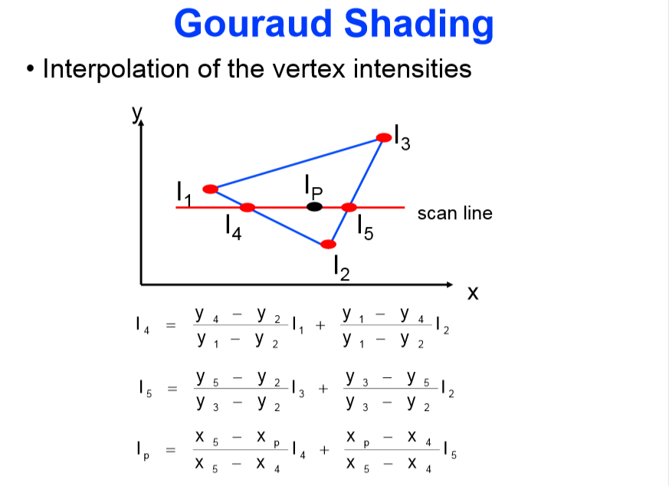

Slide 16
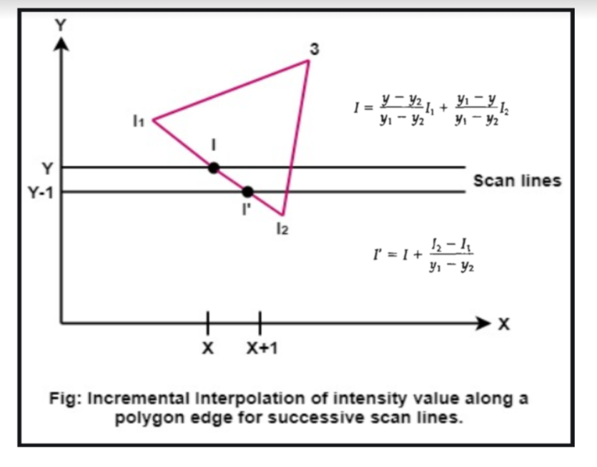

Slide 17
Advantages of Gouraud Shading Model:
The discontinuity in intensities in a constant intensity shading model are removed
To fill in the visible ploygons along each scan line this model can be combined
with a hidden surface algorithm.
Disadvantage of Gouraud Shading Model:
Sharp drop of intensity values on the polygon surface can not be displayed.
Highlights on the surface are sometimes displayed with anomalous shape
Bright and dark streaks appearing on the surface known as mach bands.

Slide 18
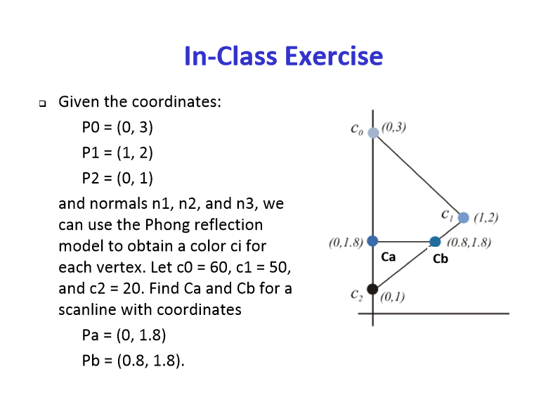

Slide 19
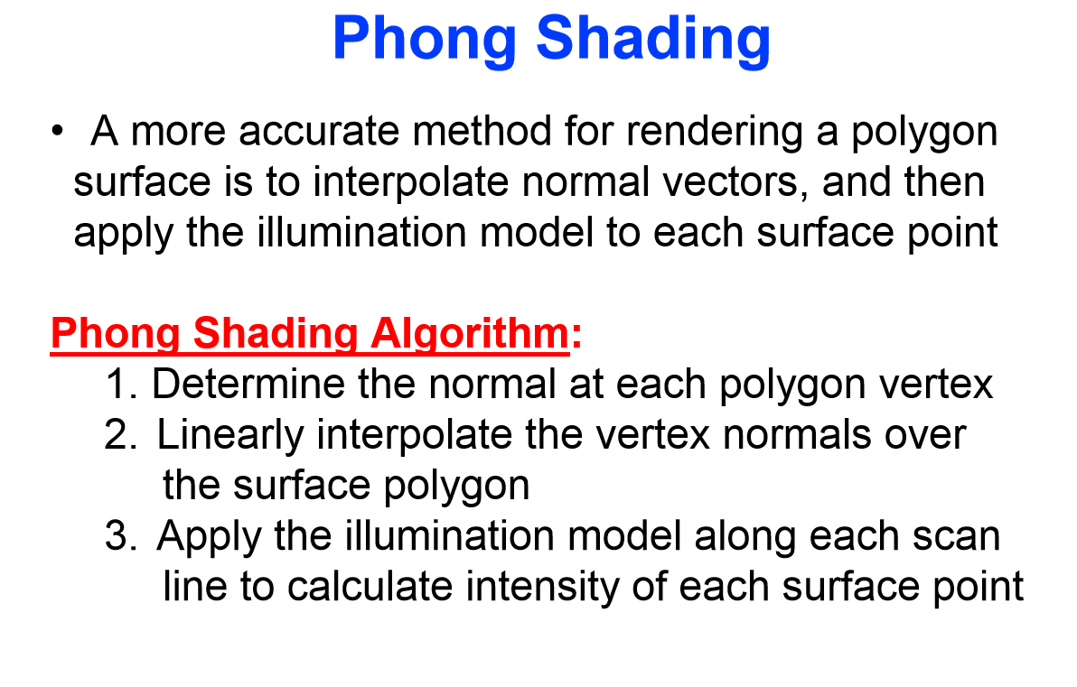

Slide 20
Phong Shading:
A more accurate interpolation based approach for rendering a polygon was developed by Phong Bui Tuong.
Basically the Phong surface rendering model is also called as normal-vector interpolation rendering.
It interpolates normal vectors instead of intensity values.
To render a polygon, Phong surface rendering proceeds as follows:
Determine the average unit normal vector at each vertex of the polygon.
Linearly interpolate the vertex normal over the projected area of the polygon.

Slide 21
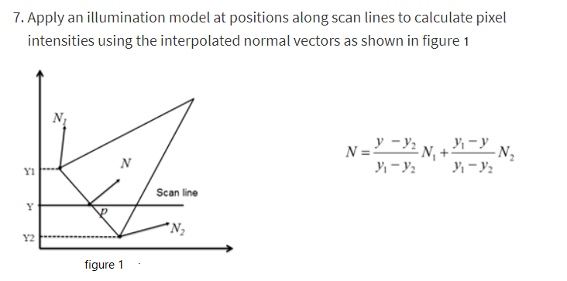

Slide 22
Phong Shading
Advantages:
i. It displays more realistic highlights on a surface.
ii. It greatly reduces the Mach band effect.
iii. It gives more accurate results.
Disadvantages:
It requires more calculations and greatly increases the cost of shading steeply.

Slide 23
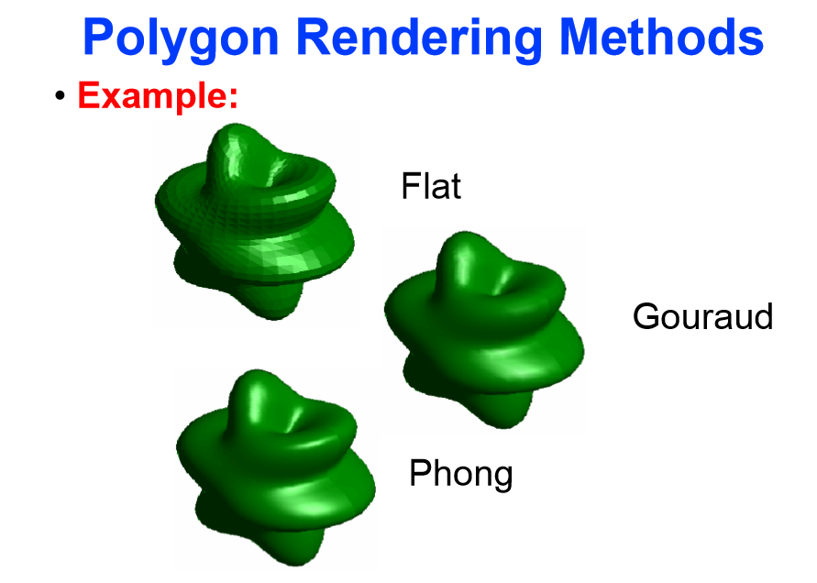

Slide 24
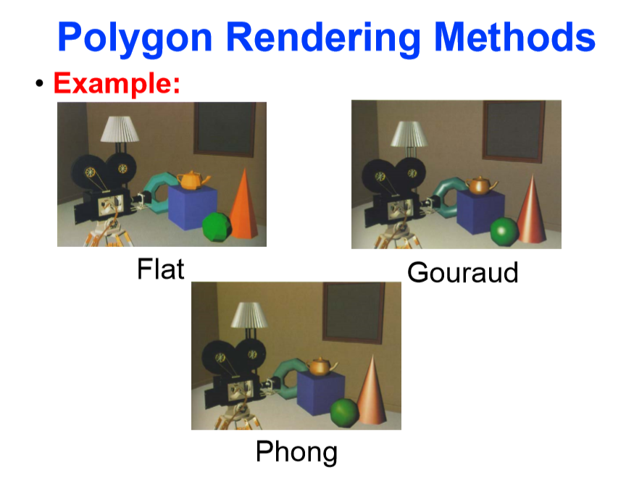

Slide 25
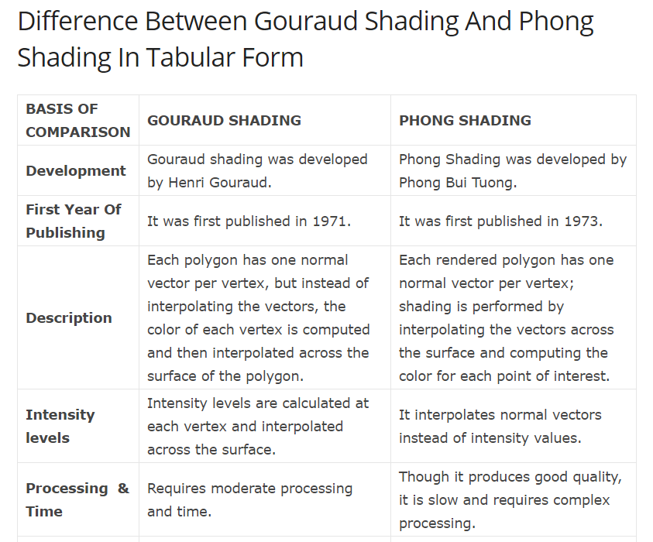

Slide 26
